Slide 1
Basic Nutrition

Slide 2
HEALTH
COMPLETE
PHYSICAL MENTAL SOCIAL

Slide 3
H E A L T H & W E L L N E S S

Slide 4
FOOD & NUTRITION
Food – Fuel to our human machine
Nutrition – A Basic Human Need - A prerequisite for a Healthy Life

Slide 5
Nutrition
The science of foods and the nutrients and other substances they contain, and of their ingestion, digestion, absorption, transport, metabolism, interaction, storage, and excretion.

Slide 6
MEANING OF NUTRITION
Science of food
Nutrients
Chemical constituents
Effect on body process & Health

Slide 7
The Nutrients
Six classes of nutrients:
Carbohydrates
Fats
Proteins
Vitamins
Minerals
Water & Fibre
kcalories: units by which energy is measured.
One kcalorie (kcal) is the amount of heat necessary to raise the temperature of 1 kilogram (kg) of water 1°C.

Slide 8
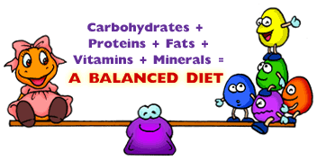
WHAT DOES FOOD PROVIDE ?
Balanced diet - achieved through blend of basic food groups

Slide 9
CLASSIFICATION (OR) TYPES OF FOOD
Three main groups according to their functions.
Energy Giving Foods: -
E.g.: - Cereals, sugar, pulses and fats
Body building and repairing Foods: -
E.g.: - Pulses, nuts, eggs, meat and fish.
Protective and regulatory Foods: -
E.g.: - Vegetables, Fruits, water, fibre

Slide 10
BASIC FIVE FOOD GROUP
Depending upon the nutritive value.
For the convenience of planning meals.
Food groups like ‘Basic Four’, ‘Basic Five’ or ‘Basic Seven’
The nutrition expert group of Indian Council of Medical Research, India

Slide 11
BASIC FIVE FOOD GROUP
FOOD GROUP | SOURCES | PROVIDE
Group I | Cereal Grains and Roots and Tubers | Primarily supply energy.
Group II | Pulses and legumes | Primarily supply protein
Group III | Milk and meat products | Foodstuffs supply energy.
Group IV | Fruits and vegetables | Rich sources of minerals and vitamins
Group V | Fats and sugar | Variety in taste and texture in the diet.

Slide 12
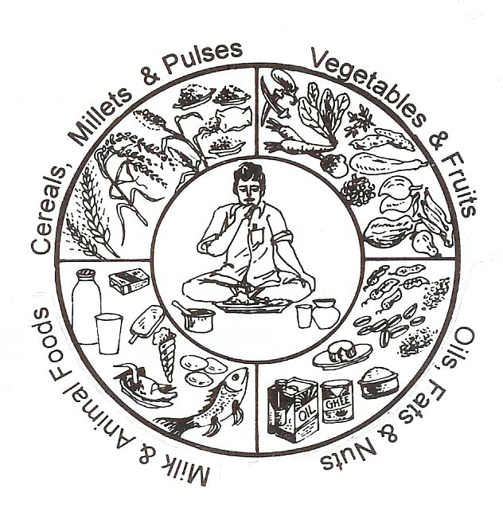
Dietary Guidelines

Slide 13
CEREALS

Slide 14
Cereal - Bread and Rice 6-11 servings a day
Children need at least 6 servings.
Teenagers and very active adults need 10 or 11 servings every day.
What is a serving? A serving is one slice of bread; 1/2 cup cooked cereal or rice

Slide 15
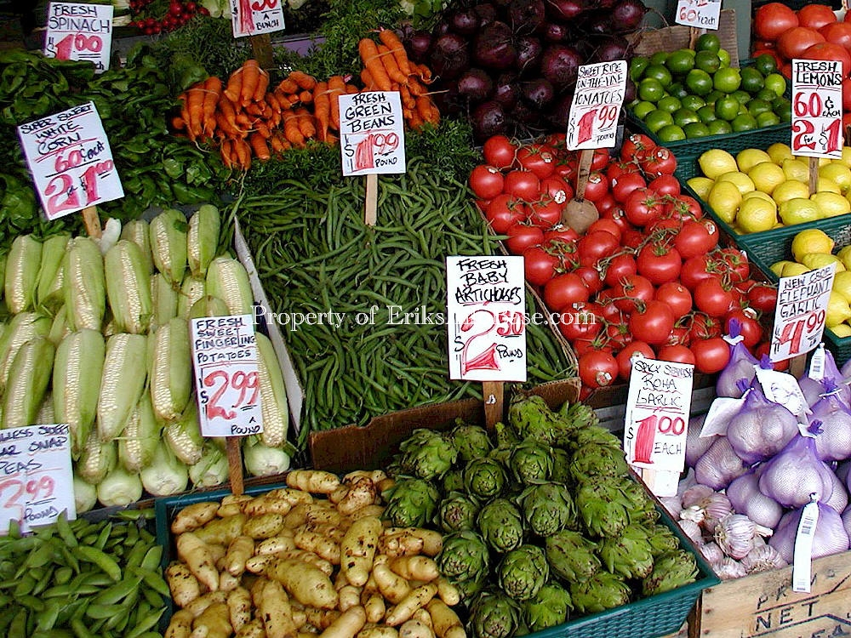
Fruits & Vegetables

Slide 16
Fruits 2-4 servings a day
Eating fruit provides health benefits
Likely to have a reduced risk of some chronic diseases.
nutrients vital for health and maintenance of your body.
They are sweet, often eaten as a dessert, for breakfast, or as a refreshing snack.

Slide 17
Vegetables 3-5 servings
Vegetable tips: Eat vegetables with meals and as snacks.
Depending on their age, one can help in clean, peel, or cut.
Pick a new vegetable to try while shopping.
Use cut-up vegetables as part of afternoon snacks.
Serve 2 vegetables separately - than mixed vegetables.

Slide 18
a. Milk & Milk Products

Slide 19
Milk, Yogurt, and Cheese 2-4 servings a day
Milk products provide protein, vitamins and minerals.
Milk, yogurt and cheese are the best sources of calcium.
Contains saturated fat and cholesterol.
They have more fat and calories.

Slide 20
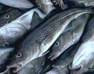
b. Meat & Poultry

Slide 21
Pulses & Legumes

Slide 22
Meat, Poultry, Fish, Dry Beans, Eggs, and Nuts 2-3 servings a day
Important sources of protein, iron, zinc, and B vitamins.
This group includes plant foods and animal foods.
Some meats and meat products are high in fat.
Trim fat from meat before cooking and eating.
You can take the skin off.

Slide 23
Fats & Sugars

Slide 24
Fats, Oils, and Sweets Use sparingly
Pyramid shows SMALL TIP fats, oils, and sweets.
Salad dressings and oils, cream, butter, margarine, sugars, soft drinks, candies, and sweet desserts.
Provide calories and little else nutritionally.
Most people should use them sparingly.
Fats and sweets can also be found throughout the rest of the pyramid, as added parts of the other food groups.

Slide 25
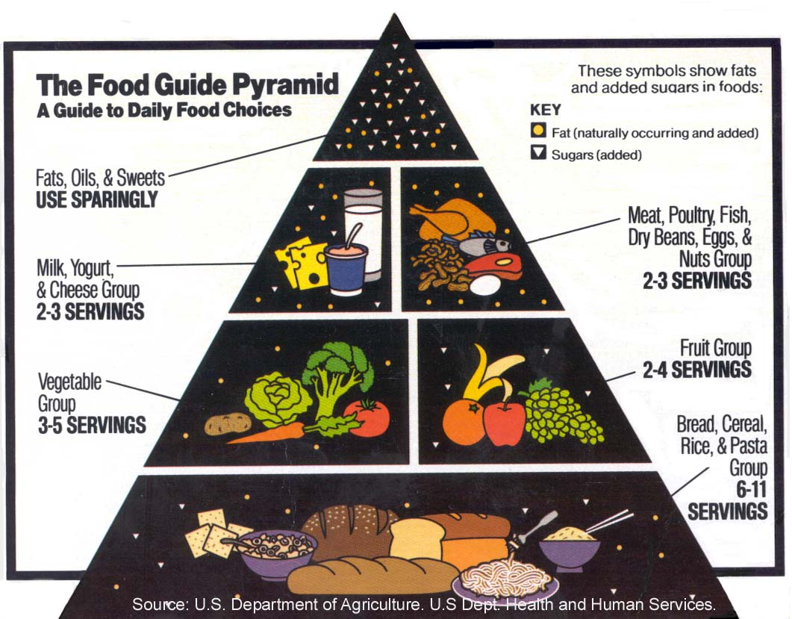

Slide 26
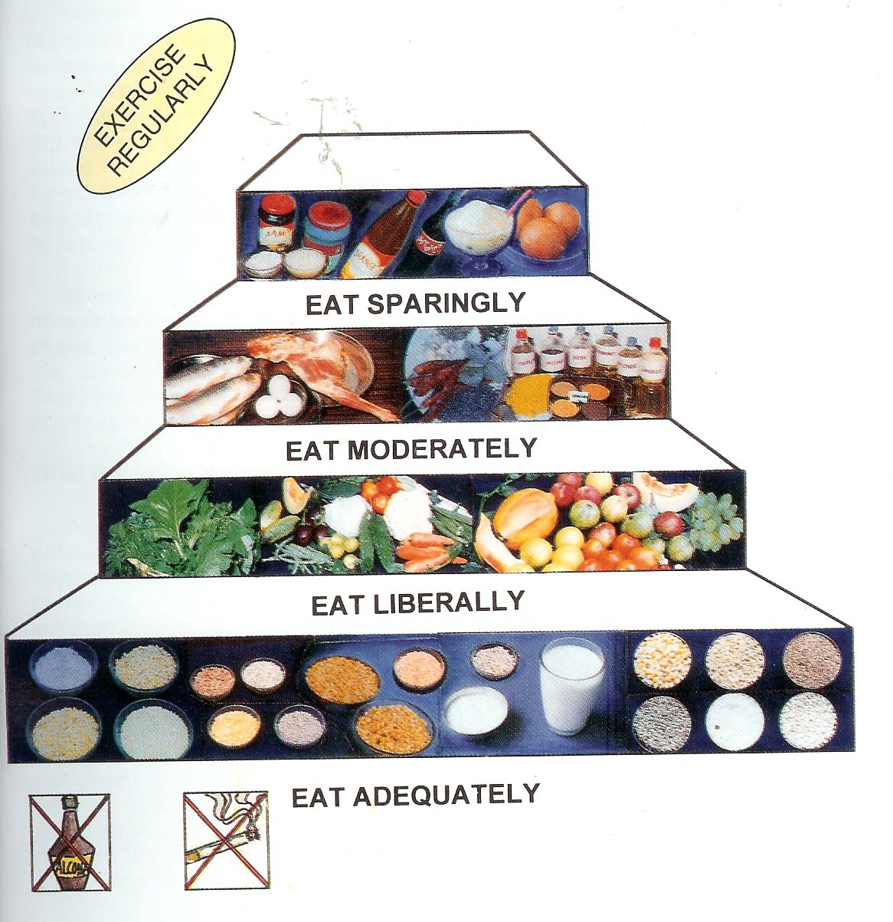
How do we plan a balanced diet?
Dietary Guidelines For Indians

Slide 27
Fat Soluble Vitamins
Vitamin A essential for good vision.
Vitamin D in milk helps your bones.
Vitamin E provides anti aging property.
Vitamin K is the secret of blood clotting

Slide 28
Water Soluble Vitamins
Vitamin B essential for glowing skin etc…..
Vitamin C in oranges helps your body heal if you get a cut .

Slide 29
An Extra inch on your Waist line is a year less on your Life line

Slide 30
Obesity increases risk of
High blood pressure
High blood cholesterol
Heart Disease
Diabetes Mellitus
Gall stones
Certain types of Cancer

Slide 31
To awaken the nation it is the woman who must be awakened Once she is on the move, the family moves, the society moves and the nation move”
UTMOST NEED FOR NUTRITION EDUCATION

Slide 32
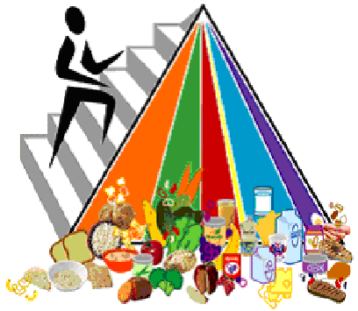
Food Pyramid and exercise
Diet
&
Exercise

Slide 33
Dietary Guidelines

Slide 34
Diet Planning Principles
Diet-planning principles:
Adequacy.
Balance.
kCalorie control.
Density (nutrient)
Moderation.
Variety.

Slide 35
THANK YOU

Slide 36
Prepared by
Ms.C.Anitha M.Sc.,M.Phil.,(Ph.D.,),
Assistant Professor,
Department of Home Science
Seethalakshmi Ramaswami College (Autonomous),
Tiruchirappalli .
Tamilnadu, INDIA– 620 002.
Mobile : 9842119011

